Slide 1
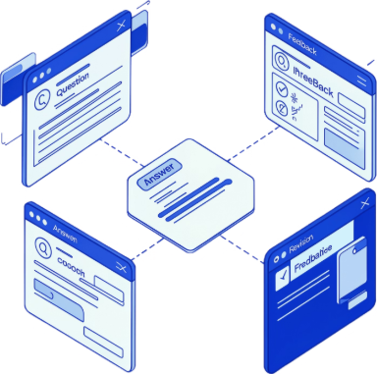

TECHNICAL INTERVIEW PRACTICE
K. V. N. Surya Teja · Backend
G. Tejesh · API Integration
A. Bhagyaraju · Frontend and UI
G. Jhon · Documentation
InterviewIQ
A backend and GenAI app: questions, answer evaluation, feedback, and saved history.

Slide 2
1
Questions start the practice
Sample questions are useful, but students may still struggle to organise and explain their thinking.
2
Scores hide the issue
A single score does not show whether the issue is relevance, structure, evidence, or clarity.
3
History is hard to review
The problem: practice does not explain what to improve
Without saved practice history, progress is difficult to review over time.
4
Project response: a backend that scores each answer on four criteria and saves feedback for the next attempt.

Slide 3

InterviewIQ – Logic & Backend Architecture
The candidate journey is one connected handoff from login to export.
Workflow Logic
Backend Architecture
AI & Evaluation Logic
1
Login → Choose → Generate
app.py: Python + Streamlit UI, interview flow, logic.
backend/evaluator.py: answer validation, AI and offline scoring.
backend/models.py: structured questions, sessions, evaluations.
backend/question_bank.py: role and topic question data.
Speech processing: recorded answers converted to text.
JavaScript + localStorage: profiles and histories in browser.
Gemini / Groq / OpenAI APIs generate role-specific questions and follow-ups.
Checks: relevance, structure, evidence and ownership, clarity.
Rejects gibberish or clearly unrelated answers before scoring.
Rule-based heuristics provide an offline fallback.
Returns scores, strengths, and improvement suggestions.
Candidate ID + PIN → select interview role → role-specific questions.
2
Answer → Validate → Evaluate
Submit typed or spoken answers → validate answers → AI evaluation.
3
Feedback → History → Export
Scores & feedback → save history → export report.
Python · Streamlit · Gemini / Groq / OpenAI APIs · HTML · CSS · JavaScript · localStorage

Slide 4
01
Practice broadly
One backend flow supports technical, behavioural, and project-based practice.
02
Explain the feedback
Score four criteria and explain strengths and areas to improve.
03
Keep the record
Save answers, follow-up questions, and scores in browser localStorage.
Four objectives guide the solution
04
Stay straightforward
A simple Streamlit interface keeps the focus on preparation.

Slide 5
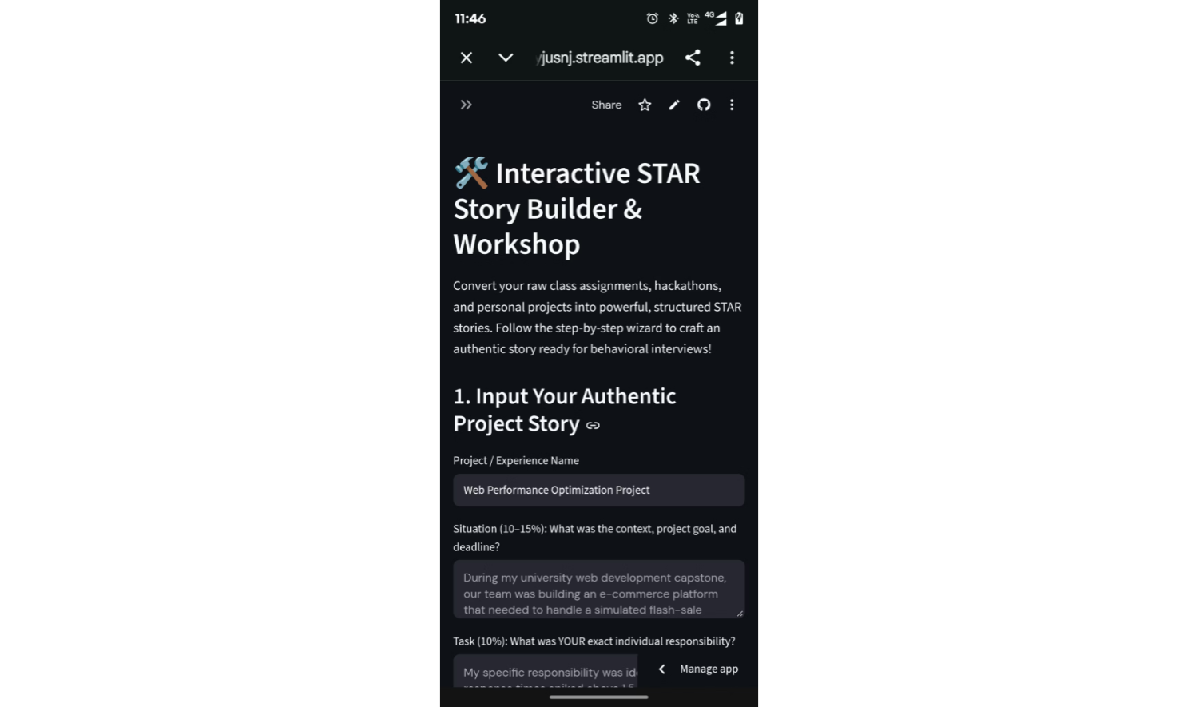
One loop connects practice to improvement
Every attempt moves through the same six steps.
1
2
3
4
5
6
Choose
Receive
Answer
Evaluate
Review
Revise
Section, target role, practice type.
A question with its expectations.
Audio or typed text.
Rubric checks run; AI feedback when an API is configured.
Relevance, structure, evidence and ownership, clarity.
Retry, revisit saved history, or export the report where supported.
Notes:
The STAR Story Builder turns project experience into a structured interview story. Walk through the Situation and Task fields for one project or experience, with guided prompts for each part. The learner can then review and improve the story.

Slide 6
InterviewIQ – Workflow and AI Mechanism
END-TO-END WORKFLOW
TECH STACK
HOW AI IS USED
Open website
Candidate ID + PIN login
Select interview role
Generate questions
Submit typed or spoken answers
Validate, then AI evaluation
Scores & feedback
Save history
Export report
Python for backend logic; Streamlit for the web interface.
Gemini / Groq / OpenAI APIs support question generation and answer evaluation.
HTML, CSS, and JavaScript support UI and browser storage.
Pandas supports data handling and analytics.
Candidate ID + PIN access; separate interview session IDs.
Mock interviews and follow-up questions.
Performance analytics and report export.
Generate role-based questions and follow-ups.
Evaluate relevance, structure, evidence, and clarity.
Provide scores, strengths, and improvement suggestions.
Rule-based offline evaluation remains available; recorded speech is converted into text.
Provide an interactive, AI-assisted platform for personalized interview practice and performance improvement.
Notes:
Walk left to right through the nine workflow steps. Then cover the tech stack with the named Gemini, Groq, and OpenAI options, how AI is used including speech-to-text and rule-based offline fallback, the key features, and the project goal.

Slide 7



Feedback is explained through four checks
Each area may be scored from 1 to 5 for practice guidance, not hiring prediction.
1
RELEVANCE
Does the answer address the question?
Improve by connecting the response directly to the prompt.
2
STRUCTURE
Is the response organised and easy to follow?
Improve by giving the answer a clear sequence.
3
EVIDENCE AND OWNERSHIP
Does the candidate explain their own actions and examples?
Improve by naming what you did and why.
4
CLARITY
Is the answer specific and understandable?
Improve by replacing broad claims with precise language.
Notes:
Four checks, scored 1 to 5 for practice guidance only. Each check pairs a question with one concrete improvement.

Slide 8


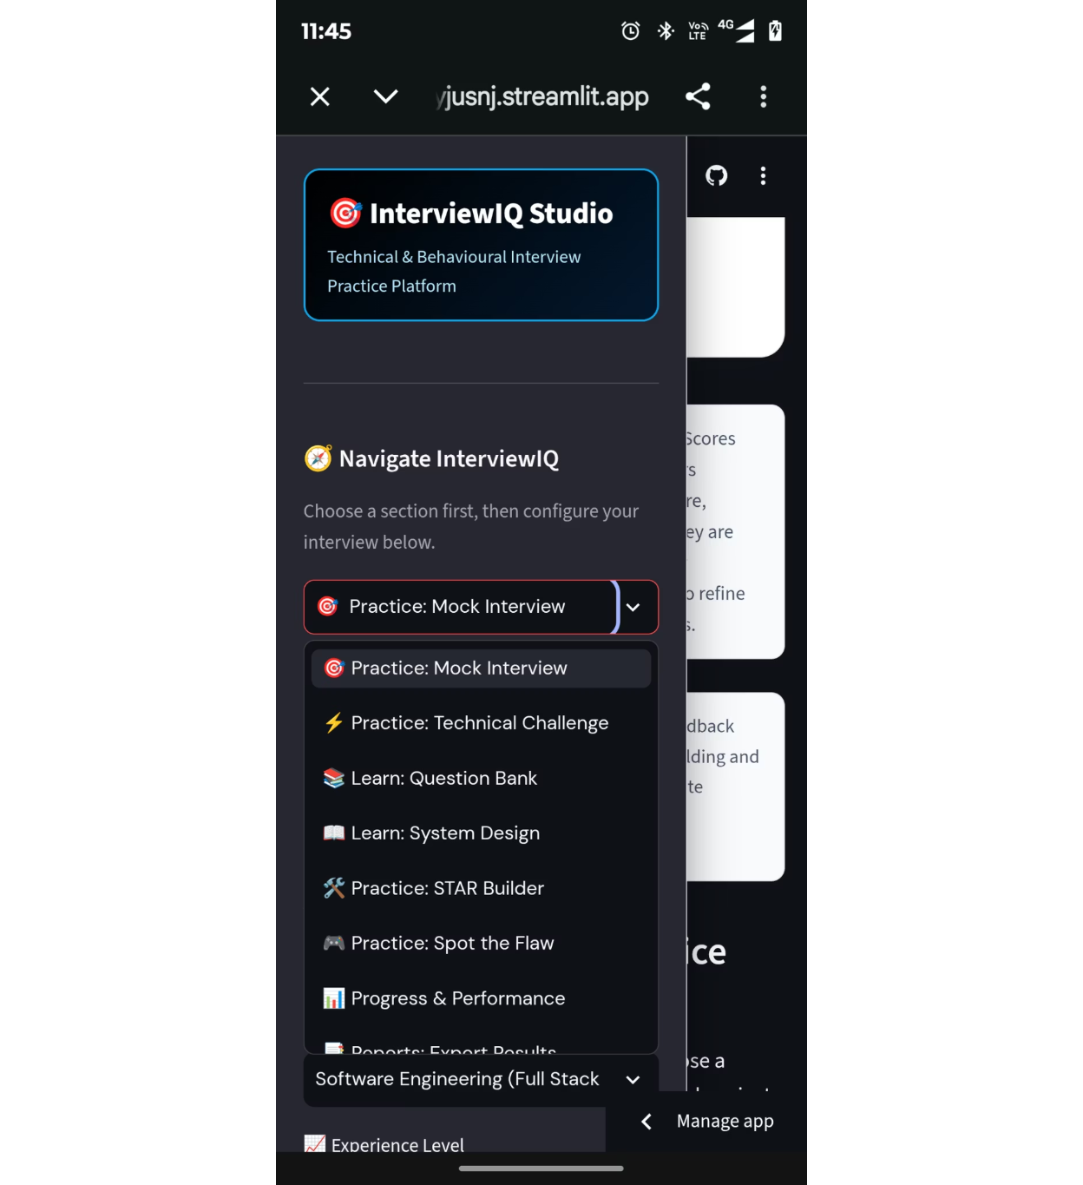



The feature set supports different preparation modes
MOCK INTERVIEWS
FOLLOW-UP PROMPTS
Technical, behavioural, and project questions.
Explain choices and think through details.
RESUME AND PROJECT REVIEW
LEARNING TOOLS
Question bank, system-design guidance, and STAR builder.
Improve how experience is presented.
PROGRESS TOOLS
Performance analytics with Pandas and report export where supported.
Notes:
The sidebar is the main navigation. It shows InterviewIQ Studio branding, then the practice modes: mock interview, technical challenge, question bank, system design, STAR builder, and spot the flaw. Progress and performance and export results sit with the learning tools. Role selection lets the learner choose the target role first.

